Slide 1
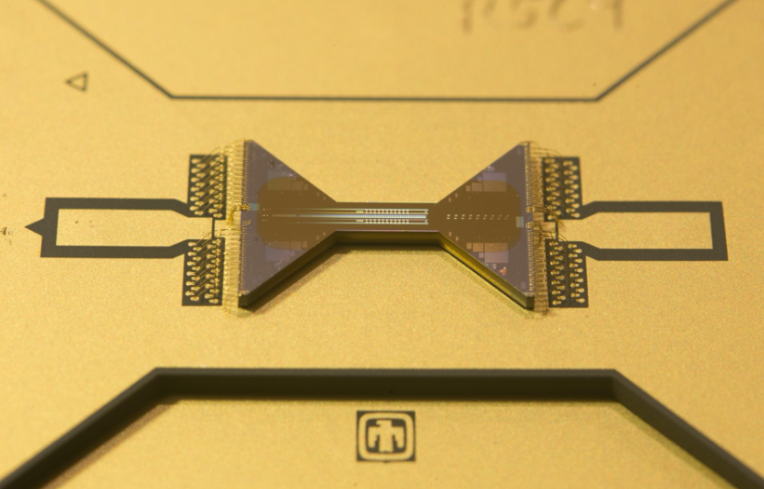
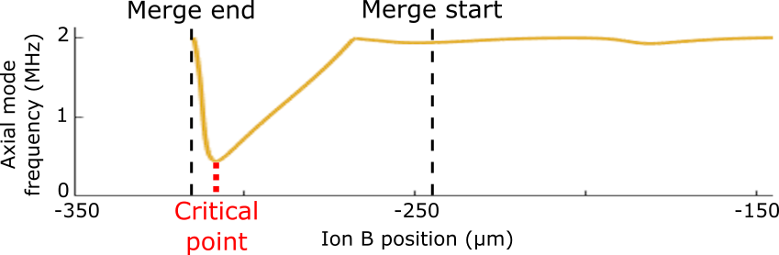
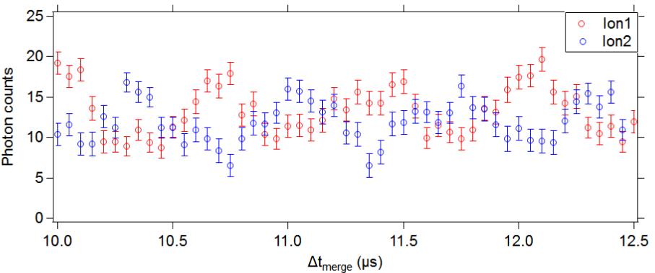
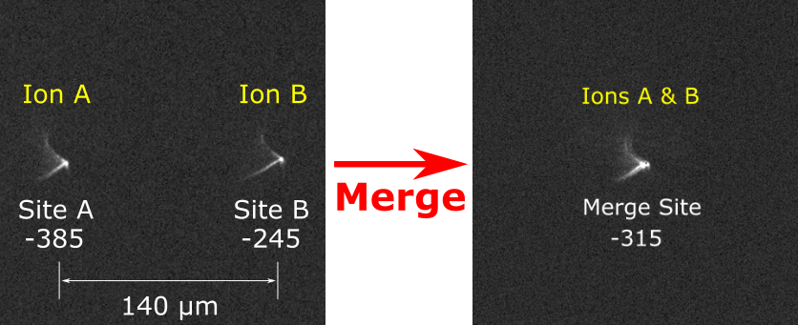
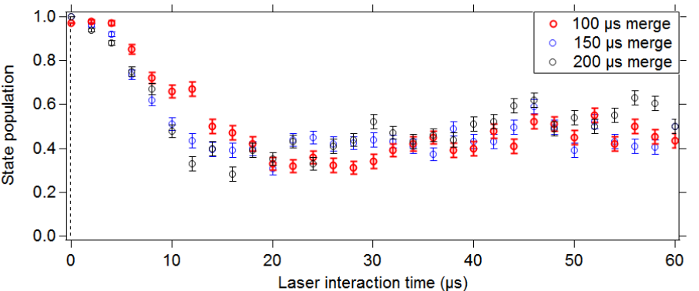
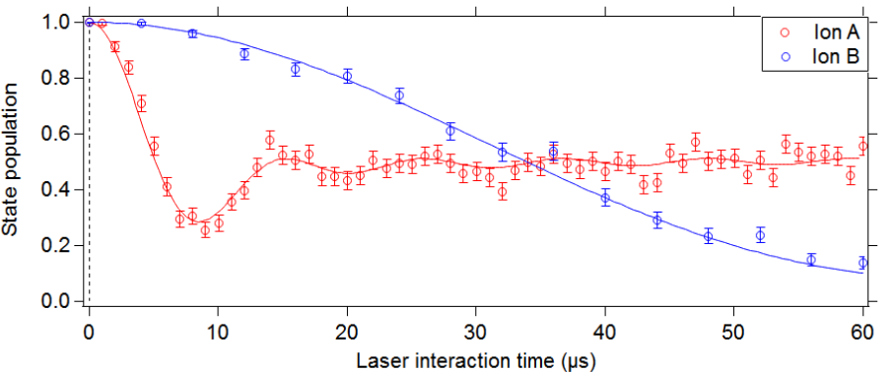
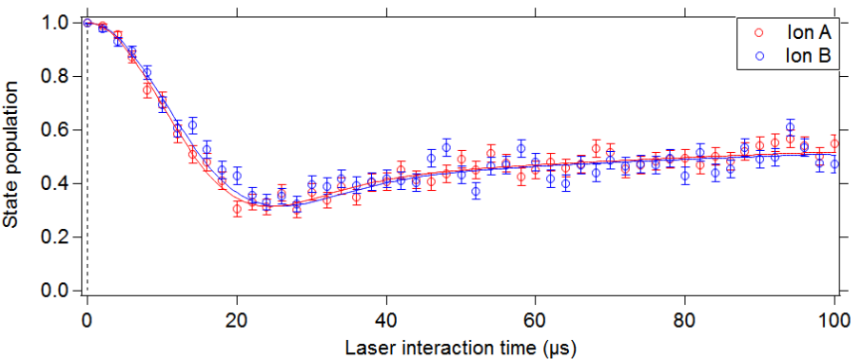
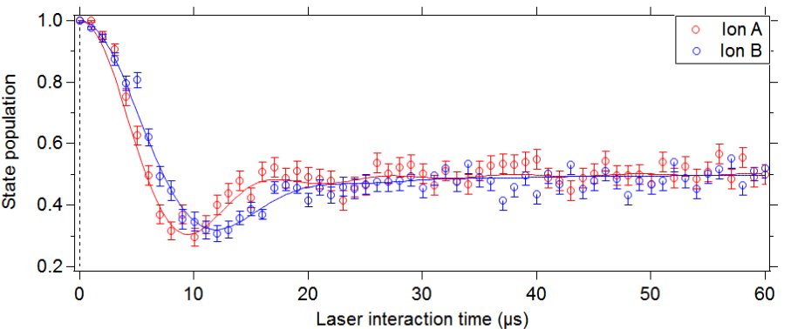
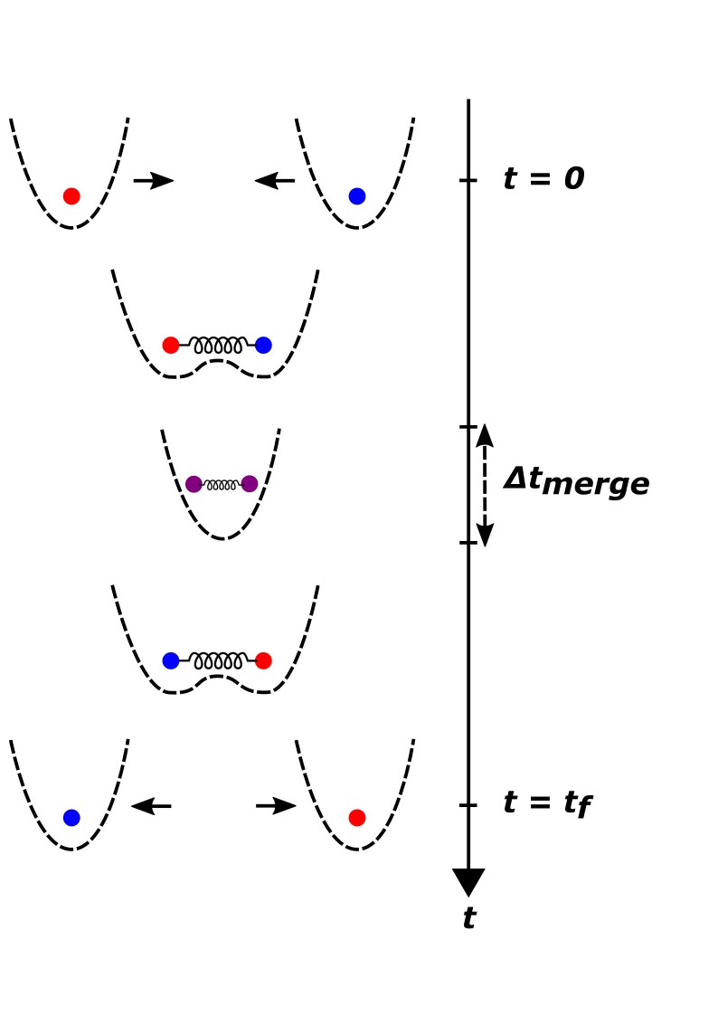
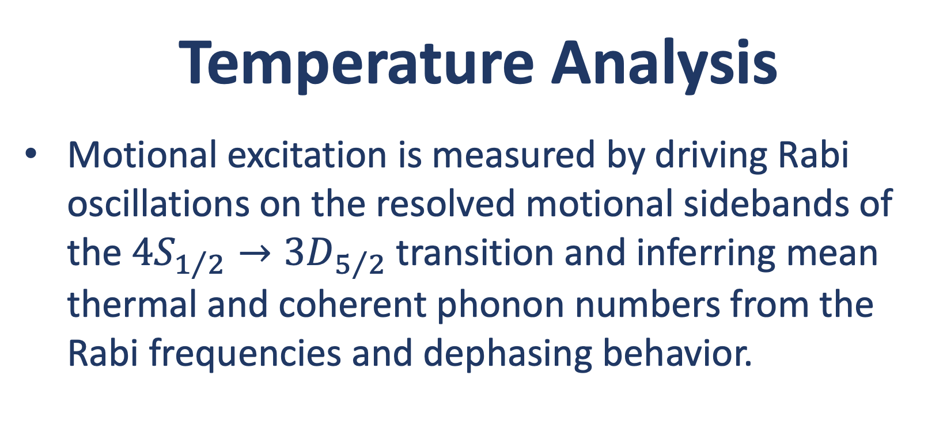








Towards laser-free dynamical cooling via exchange with a pre-cooled ion
V. S. Sandhu, S. D. Fallek, H. N. Tinkey, R. A. McGill, C. R. Clark & K. R. Brown
Georgia Tech Research Institute, Atlanta, GA
Background & Motivation
During computation, ions are unavoidably heated, to the detriment of further operations, via imperfect transport, trap potential fluctuations, and anomalous heating.
Modern experiments sympathetically cool a computational ion with an ion of a different species.
Advantages: Preserves the qubit state of the computational ion by eliminating photon scattering at resonant frequencies.
Disadvantages: Cooling is slow (typically on the order of ms) [1, 2] and requires extra lasers to address transitions of the coolant ion.
Full energy exchange between two ions, a and b, in separate harmonic wells, mediated by the Coulomb interaction, has been demonstrated [3] with exchange rate given by
$$Ω_{ex}=\frac{q_{a}q_{b}}{2πε_{0}s_{0}^{3}\sqrt{m_{a}m_{b}}\sqrt{ω_{0a}ω_{0b}}}$$
where $q_{a}=q_{b}=e$ is the electron charge, m_{a} and m_{b} are the ion masses, ω_{0a} and ω_{0b} are the ion axial mode frequencies, and s₀ is the distance between harmonic wells.
We aim to utilize fast ion transport with low motional excitation in order to implement a similar exchange in significantly less time by introducing a merge/split.
Experimental Setup
Transport
Simulated axial trap frequency for a single ion during the merge sequence, as a function of the equilibrium position of Ion B:
Results
Using an ”incorrect” axial compensation field to impart large coherent motional excitation to one ion prior to the merge causes measurable motional energy exchange at the expected period of 680 ns:
⁴⁰Ca⁺ ions are held in a Sandia Peregrine linear surface-electrode trap under UHV.
Trap cooled to 4.5 K using cryostat.
Cool ions to motional ground state
Merge
Split
Analysis on blue axial sideband
Detection
Experiment zone has 22 inner segmented DC electrode pairs with 70 μm width.
DC electrode control voltages supplied by National Instruments PXIe-5413 waveform generators with ±12 V range, 0.37 mV resolution, and 200 Ms/s sample rate.
Axial trap frequency of 2.0 MHz.
Δt_{merge}
Scan variable
Minimizing thermal excitation added during merge/split:
35 kHz lowpass filters.
Optimization of axial compensation field near critical point.
Rabi experiments measuring blue sideband of axial COM mode of merged ions show thermal excitation decreases with faster merge:
Cool ions to motional ground state
Merge
Adiabatic transport to Site B
Analysis on blue sideband of axial COM mode
Detection
Removal of 18 motional quanta from a Doppler heated ion via exchange with a coolant ion for Δt_{merge} = 12.4 μs:
Doppler heat Ion A and cool Ion B
Analysis on blue axial sideband
Detection
Merge
Split
Prior to exchange:
Temperature Analysis
Motional excitation is measured by driving Rabi oscillations on the resolved motional sidebands of the $4S_{1/2}→3D_{5/2}$ transition and inferring mean thermal and coherent phonon numbers from the Rabi frequencies and dephasing behavior.
Lowest motional excitation achieved after merge and split with total transport time of 200 μs:
Cool ions to motional ground state
Merge
Split
Analysis on blue axial sideband
Detection
Ion A: ${\overline{n}}_{th}$ = 71(4)
Ion B: ${\overline{n}}_{th}$ = 0.26(2)
After exchange:
Exchange Cooling
A hot ion and a pre-cooled coolant ion are transported and merged into the same harmonic potential well. During and after the merge, the ions undergo an energy exchange process mediated by the Coulomb interaction. The exchange rate while merged is given by:
$$Ω_{ex}=ω_{BM}−ω_{COM}$$
The ions are then separated and transported back to their original locations, where the coolant ion can be re-cooled and the computational ion can resume operations.
The time spent in the same harmonic potential, Δt_{merge} , and the total time, t_{f} , can be individually modified such that maximum energy is transferred from the hot ion to the coolant ion after the entire process has taken place.
Ion A: ${\overline{n}}_{th}$ = 6.5(3)
Ion B: ${\overline{n}}_{th}$ = 6.8(4)
Ion A: ${\overline{n}}_{th}$ = 53(3)
Ion B: ${\overline{n}}_{th}$ = 37(2)
Future Work
References
Optimize merge for minimal motional excitation.
Shorten exchange time and implement multiple exchanges.
Numerically simulate exchange process from start to finish.
[1] Jost, J. et al. Entangled mechanical oscillators. Nature 459, 683-685 (2009).
[2] Pino, J. M. et al. Demonstration of the trapped-ion quantum CCD computer architecture. Nature 592, 209-213 (2021).
[3] Brown, K. R. et al. Coupled quantized mechanical oscillators. Nature 471, 196-199 (2011).
This work was done in collaboration with Los Alamos National Laboratory.

Slide 2
Defining a Harmonic Potential Well in a Linear Paul Trap
Ryan A. McGill
Georgia Tech Research Institute, Atlanta, GA 30318
Background & Motivation
Results
Ion Traps
Atomic ion traps serve as sensors, qubits in quantum computing, and as platforms to study atomic physics.
Trapping requires lasers of multiple wavelengths to provide photoionization to eject an electron from an atomic source and laser cool keep it cold within the confining potential.
Trapping Potentials
Keeping an ion suspended in one place, called trapping, can be done with electric (Paul traps) or magnetic fields (Penning traps).
Earnshaw’s Theorem states that a charged particle must have an alternating potential as DC potentials are not enough to contain the ion
NI
r
D
D
Simulation
Ryan.McGill@gtri.gatech.edu

